Slide 1
Oracle 9i Labs LAB 7
PREPARED BY:
Shoaib Raza

Slide 2
Lesson A Objectives
After completing this lesson, you should be able to:
Describe the fundamentals of the PL/SQL programming language
Write and execute PL/SQL programs in SQL*Plus
Execute PL/SQL data type conversion functions
Display output through PL/SQL programs
Manipulate character strings in PL/SQL programs

Slide 3
PL/SQL
When the PL/SQL engine is located on the client, as it is in the Oracle Developer Tools, the PL/SQL processing is done on the client side.
All SQL statements that are embedded within the PL/SQL block are sent to the Oracle server for further processing. When PL/SQL block contains no SQL statement, the entire block is executed on the client side.

Slide 4
DIFFERENCE BETWEEN PL/SQL AND SQL
When a SQL statement is issued on the client computer, the request is made to the database on the server, and the result set is sent back to the client.
As a result, a single SQL statement causes two trips on the network. If multiple SELECT statements are issued, the network traffic increase significantly very fast. For example, four SELECT statements cause eight network trips.
If these statements are part of the PL/SQL block, they are sent to the server as a single unit. The SQL statements in this PL/SQL program are executed at the server and the result set is sent back as a single unit. There is still only one network trip made as is in case of a single SELECT statement.

Slide 5
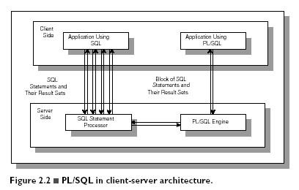
Comparison of SQL*PLUS and PL/SQL

Slide 6
PL/SQL BLOCK STRUCTURE
DECLARE (optional)
- variable declarations
BEGIN (required)
- SQL statements
- PL/SQL statements or sub-blocks
EXCEPTION (optional)
- actions to perform when errors occur
END; (required)

Slide 7
PL/SQL Block Types
Anonymous
DECLARE
BEGIN
-statements
EXCEPTION
END;
Procedure
PROCEDURE <name>
IS
BEGIN
-statements
EXCEPTION
END;
Function
FUNCTION <name>
RETURN <datatype>
IS
BEGIN
-statements
EXCEPTION
END;

Slide 8
DECLARATION SECTION
The declaration section is the first section of the PL/SQL block.
It contains definitions of PL/SQL identifiers such as variables, constants, cursors and so on.

Slide 9
PL/SQL Variables and Data Types
SYNTAX:
Variable declaration syntax:
variable_name data_type_declaration;
VARIABLES TYPES:
SCALER VARIABLE
COMPOSITE VARIABLE
REFERENCE VARIABLE

Slide 10
Composite Variables
Data object made up of multiple individual data elements
Data structure contains multiple scalar variables
Composite variable data types include:
RECORD (multiple scalar values similar to a table’s record)
TABLE (tabular structure with multiple columns and rows)
VARRAY (variable-sized array. Tabular structure that can expand or contract based on data values)
ARRAY

Slide 11
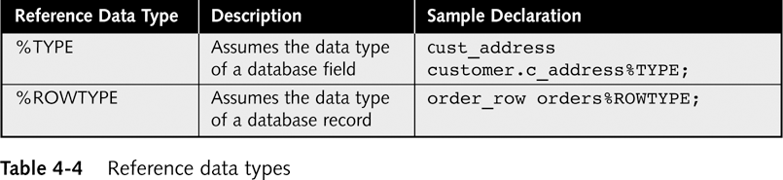
Reference Variables
Directly reference specific database column or row
Assume data type of associated column or row
%TYPE data declaration syntax:
variable_name tablename.fieldname%TYPE;
%ROWTYPE data declaration syntax:
variable_name tablename%ROWTYPE;

Slide 12
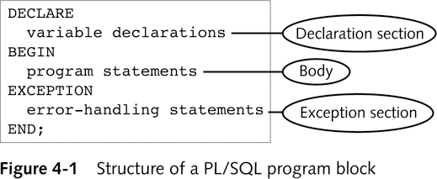
PL/SQL Program Blocks
Declaration section
Optional
Execution section
Required
Exception section
Optional
Comment statements
Enclosed within /* and */ for several lines’ comments
-- for single line comments
/* Script: Student register Purpose: to enroll students in class */
-- Script: Student register -- Purpose: to enroll students

Slide 13
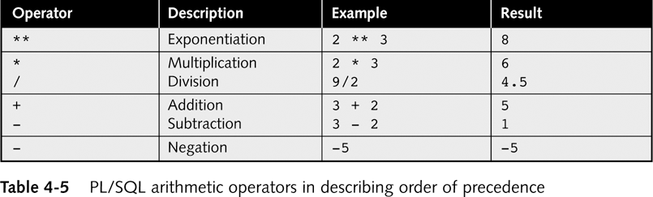
PL/SQL Arithmetic Operators in Describing Order of Precedence
Parentheses are used to force PL/SQL interpreter to evaluate operations in a certain order
Questions: 2 * 2 ** 2 = ? 100 / 2 * 5 = ?

Slide 14
Assignment Statements
DECLARE variable1 NUMBER := 0;
variable2 NUMBER := 0;
BEGIN
variable2 := variable1 +1;
END;
Assigns value to variable
Operator: :=
Syntax: variable_name := value;
String literal within single quotation mark
Examples:
current_s_first_name := ‘Tammy’;
current_student_ID NUMBER := 100;
Result of adding a value to a NULL value is another NULL value
DEFAULT keyword can be used instead of assignment operator
Q: What is the final value of variable2?

Slide 15
Displaying PL/SQL Program Output in SQL*Plus
PL/SQL output buffer
Memory area on database server
Stores program’s output values before they are displayed to user
Default buffer size is 2000 bytes
Should increase size if you want to display more than a few lines in SQL Plus to avoid buffer overflow error
Syntax: SET SERVEROUTPUT ON SIZE buffer_size
Example: SET SERVEROUTPUT ON SIZE 4000

Slide 16
Displaying PL/SQL Program Output in SQL*Plus (continued)
DBMS_OUTPUT
is an Oracle built-in package
Consists of a set of programs for processing output
PUT_LINE is the DBMS_OUTPUT procedure for displaying output
Syntax: DBMS_OUTPUT.PUT_LINE('display_text');
Example: DBMS_OUTPUT.PUT_LINE(current_s_first);
Displays maximum of 255 characters of text data
If try to display more than 255 characters, error occurs

Slide 17
Writing a PL/SQL Program
Write PL/SQL program in Notepad or another text editor
Indenting commands within each section is a good programming practice. Will loose points if code is not indented
Copy and paste program commands from text editor into SQL*Plus
Press Enter after last program command
Type front slash ( / )
Then press Enter again

Slide 18
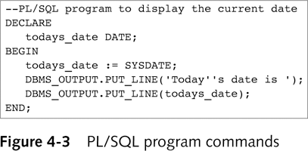
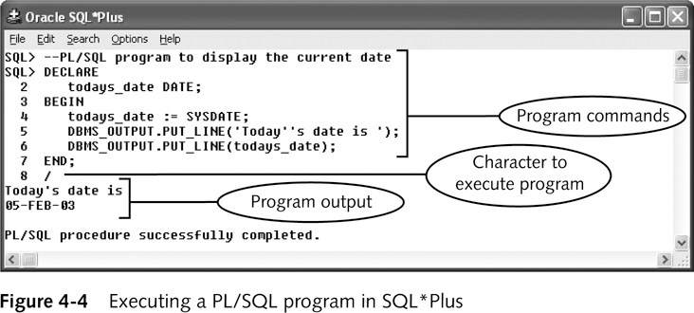
PL/SQL Program Commands

Slide 19
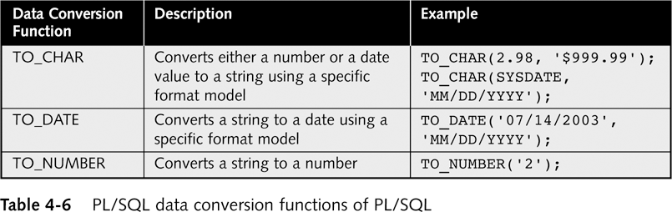
PL/SQL Data Conversion Functions
WHERE O_DATE = TO_DATE (‘29/05/2006’, ‘DD/MM/YYYY’)
WHERE O_DATE = ‘29/05/2006’
Implicit data conversions
Interpreter automatically converts value from one data type to another
If PL/SQL interpreter unable to implicitly convert value error occurs
Explicit data conversions
Convert variables to different data types
Using data conversion functions

Slide 20
Manipulating Character Strings
Concatenating
Joining two separate strings
Operator: || (i.e. double bar)
Syntax: new_string := string1 || string2;
Example: s_fullname := s_first || s_last;
Parse
Separate single string consisting of two data items separated by commas or spaces
s_fullname := s_first ||‘ ’|| s_last;
Variable | Data type | Value
Bldg_code | VARCHAR2 | LH
Room_num | VARCHAR2 | 101
Room_capacity | NUMBER | 150
room_message := bldg_code || ‘ Room ’ || room_num || ‘ has ’ || TO_CHAR(room_capacity) || ‘seats.’;
Question: Write down the value of room_message after the above Assignment statement is executed.

Slide 21
Removing Blank Leading and Trailing Spaces from Strings
LTRIM function
Remove blank leading spaces
string := LTRIM(string_variable_name, string to delete);
RTRIM function
Remove blank trailing spaces
string := RTRIM(string_variable_name, string to delete);
DECLARE
s_address varchar2(20):='951 super Dr' ;
BEGIN
s_address := RTRIM(s_address,'Dr');
dbms_output.put_line(s_address);
END;
/
Questions: How many characters will be removed from the string assigned to the s_address variable when the RTRIM function in the avove PL/SQL block is executed

Slide 22
Finding the Length of Character Strings
LENGTH(NULL) Result: NULL LENGTH('') Result: NULL LENGTH(' ') Result: 1 LENGTH('Tech on the Net') Result: 15
LENGTH function syntax
string_length := LENGTH(string_variable_name);
Example:
LENGTH(NULL) Do it Quickly!!!
Result:
LENGTH(‘’)
Result:
LENGTH(‘ ')
Result:
LENGTH('Tech on the Net')
Result:

Slide 23
PL/SQL EXAMPLE
SET SERVEROUTPUT ON
DECLARE
v_emp_name VARCHAR2(35);
v_job VARCHAR2(35);
BEGIN
SELECT ename, job
INTO v_emp_name, v_job
FROM emp
WHERE empno = 7369;
DBMS_OUTPUT.PUT_LINE
('Employee '||v_emp_name||' works as '||v_job);
EXCEPTION
WHEN NO_DATA_FOUND THEN
DBMS_OUTPUT.PUT_LINE
('There is no employee with id 7369');
END;
/

Slide 24
SUBSTITUTIONVARIABLES
SQL*Plus allows a PL/SQL block to receive input information with the help of substitution variables.
Substitution variables cannot be used to output the values because no memory is allocated for them.
SQL*Plus will substitute a variable before the PL/SQL block is sent to the database.
Substitution variables are usually prefixed by the ampersand(&) character or double ampersand (&&) character.

Slide 25
YOUR TASK….
WRITE A PROGRAM THAT WILL ASK EMPLOYEE NO AND PRINTS ITS NAME AND JOB ON SCREEN.

Slide 26
IF-THEN STATEMENTS
An IF-THEN statement is the most basic kind of a conditional control and has the following structure:
IF CONDITION
THEN
STATEMENT 1;
…
STATEMENT N;
END IF;
The reserved word IF marks the beginning of the IF statement.
Statements 1 through N are a sequence of executable statements that consist of one or more of the standard programming structures.

Slide 27
YOUR TASK------
WRITE A PROGRAM IN PL/SQL THAT COMPARES TWO NUMBERS AND PRINTS THE GREATER NUMBER.

Slide 28
Example
DECLARE
v_num1 NUMBER := 5;
v_num2 NUMBER := 3;
v_temp NUMBER;
BEGIN
-- if v_num1 is greater than v_num2 rearrange their
-- values
IF v_num1 > v_num2
THEN
v_temp := v_num1;
v_num1 := v_num2;
v_num2 := v_temp;
END IF;
-- display the values of v_num1 and v_num2
DBMS_OUTPUT.PUT_LINE('v_num1 = '||v_num1);
DBMS_OUTPUT.PUT_LINE('v_num2 = '||v_num2);
END;

Slide 29
IF-THEN-ELSE STATEMENT
IF CONDITION
THEN
STATEMENT 1;
ELSE
STATEMENT 2;
END IF;
STATEMENT 3;
When CONDITION evaluates to TRUE, control is passed to STATEMENT 1;
When CONDITION evaluates to FALSE, control is passed to STATEMENT 2.
After the IF-THEN-ELSE construct has completed, STATEMENT 3 is executed.

Slide 30
YOUR TASK------
WRITE A PROGRAM IN PL/SQL THAT TAKES A NUMBER AS INPUT AND FINDS THAT IT’S AN ODD NUMBER OR EVEN NUMBER……..

Slide 31
SOLUTION
DECLARE
v_num NUMBER := &sv_user_num;
BEGIN
-- test if the number provided by the user is even
IF MOD(v_num,2) = 0
THEN
DBMS_OUTPUT.PUT_LINE(v_num||' is even number');
ELSE
DBMS_OUTPUT.PUT_LINE(v_num||' is odd number');
END IF;
DBMS_OUTPUT.PUT_LINE('Done…');
END;

Slide 32
ELSIF STATEMENTS
An ELSIF statement has the following structure:
IF CONDITION 1
THEN
STATEMENT 1;
ELSIF CONDITION 2
THEN
STATEMENT 2;
ELSIF CONDITION 3
THEN
STATEMENT 3;
…
ELSE
STATEMENT N;
END IF;

Slide 33
YOUR TASK-----
WRITE A PROGRAM IN PL/SQL THAT FINDS THE NUMBER IS POSITIVE OR NEGATIVE OR EQUALS TO ZERO.

Slide 34
Example
DECLARE
v_num NUMBER := &sv_num;
BEGIN
IF v_num < 0
THEN
DBMS_OUTPUT.PUT_LINE (v_num||‘ is a negative number’);
ELSIF v_num = 0
THEN
DBMS_OUTPUT.PUT_LINE (v_num ||‘ is equal to zero’);
ELSE
DBMS_OUTPUT.PUT_LINE (v_num||‘ is a positive number’);
END IF;
END;

Slide 35
END

